Slide 1

Production Process & Jobs

Slide 2

Jobs – The Director
This is the person responsible for interpreting the script, planning blocking and movement, and rehearsing the actors.
The director oversees all aspects of a production
MUST HAVE “VISION”

Slide 3

Jobs – The Producer
This is the person responsible for the finances of a production
Often works closely with the Business and Marketing people
Has final say on many decisions because of the $$$

Slide 4

Jobs – Stage Manager (SM)
This person is the second in command after the Director
The SM is the organizational leader of the show
During rehearsals, the SM is responsible for attendance, scheduling, recording, communicating
A good SM is organized, patient, self-motivated, firm, and kind
Once performances begin, the SM runs
the show and calls all the cues

Slide 5
Jobs - Actor
The actor analyzes the play & his/her character
Actors take direction from the Director
Actors are responsible for memorizing lines and blocking, attending rehearsals, caring for props & costumes, and performing

Slide 6

Jobs – Technical Director
The Tech Director (or Tech Manager – TM) supervises all the tech crews
The TM coordinates and monitors all tech work
The TM communicates with the SM, the Director, and the Producer to make sure the production concept fits the Director’s vision and the budget

Slide 7

Jobs – Set Crew
The Set crew analyzes the script and designs the set according to the Director’s vision
Set crew will create (build, paint, construct) the set for the play
The Set crew is responsible
for maintaining, fixing (if needed),
and striking the set

Slide 8
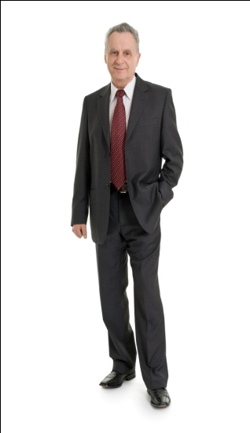
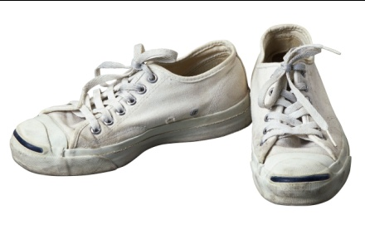
Jobs – Costume Crew
Costume crew analyzes the script and designs costumes and accessories according to the Director’s vision
The Costume crew is responsible for creating (sewing), modifying, or finding the clothing, shoes, and accessories worn by each character

Slide 9
Jobs – Prop Crew
The Prop crew analyzes the script to determine the props needed for the show following the Director’s vision
The Prop crew creates/builds or finds the needed props, and maintains them through the run of the show
This crew may also be responsible
for decorating the set

Slide 10
Jobs – Light Crew
The light crew analyzes the script and designs lighting to fit the needs of the show following the Director’s vision
The Light crew will hang, focus, color, and maintain the lighting instruments needed
The Light crew will program and run the light board

Slide 11

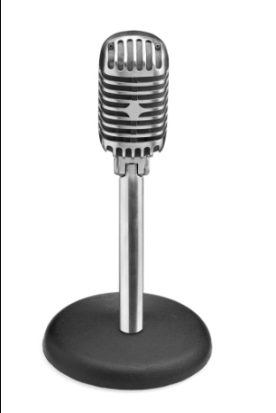
Jobs – Sound Crew
The sound crew analyzes the script and designs the sound and effects according to the Director’s vision
The sound crew works with the actors and musicians to amplify their voices/instruments
The sound crew finds or creates the needed sound effects
The Sound crew runs the equipment, maintains mics, and runs the sound board

Slide 12

Jobs – Hair & Makeup
Hair & Makeup Crew will analyze the script and design according to the Director’s vision
The crew designs and creates standard and special-effects hair designs
The crew designs and creates straight and special-effects makeup
The crew will maintain the hair &
makeup tools an materials

Slide 13

Jobs – Business Manager
Business Manager works with
the Producer and Director to stay
on budget
The Business Manager runs the
marketing and publicity plan for the show, sells tickets, designs and creates the program, and sells advertising
The Business Manager works with the House Manager to take care of the audience

Slide 14
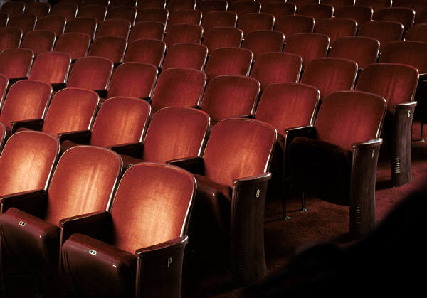
Jobs – House Manager
The House Manager works with the Producer and the Business Manager to take care of the audience
The House Manager, with the Business Manager, runs the lobby and the house, supervises the ticket sales, ushers, and concessions

